Slide 1
HTML 5 Video, Audio, Canvas

Slide 2
Html 5 video
This allows the website creator to embed video into the page itself instead of having to use flash or java to help load it. It gives you the option to put in separate source files incase a browser doesn’t support the original file. It also allows you to put in an alternate saying in case the browser doesn’t support any of the source files.

Slide 3



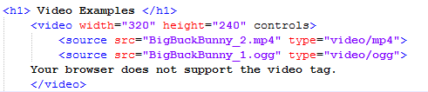
Types of Video
Mp4- Supported by most browsers
Ogg-supported by linux and other VLP video players
Code Example (will preview later)

Slide 4
Html 5 Audio
This allows the website creator to embed audio into the page itself instead of having to use flash or java to help load it. It gives you the option to put in separate source files incase a browser doesn’t support the original file. It also allows you to put in an alternate saying in case the browser doesn’t support any of the source files.

Slide 5

Mp3-supported by most browsers
Ogg-Supported by Linux and other vlp video players
Example (to be viewed later)

Slide 6
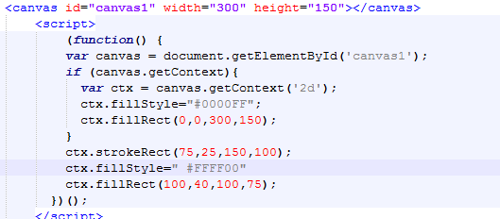
Html 5 canvas
Canvas is actually really awesome! It creates an area for you to draw or use JavaScript to manipulate. You can make it draw pictures, create shapes or other images.

Slide 7
Good Resources for Canvas
https://www.w3schools.com/tags/ref_canvas.asp
JumpStart HTML5 by TIFFANY B. BROWN, KERRY BUTTERS, and SANDEEP PANDA
HTML 5 & CSS3 for the Real World by Alexis Goldstein, Louis Lazaris, and Estelle Weyl

